Slide 1
Types of Power
Federalism in practice

Slide 2
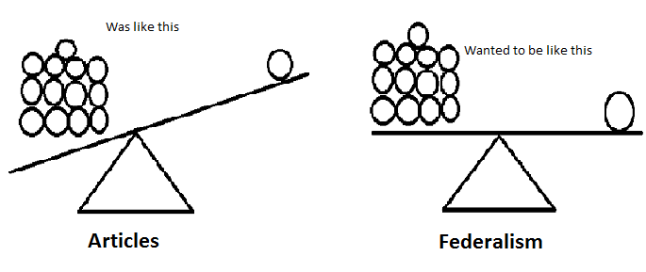
Federalism in Practice
The Constitution produces a “Dual” system of government: which means there are two basic levels of government, each with its own field of authority, and operating over the same people at the same time.

Slide 3
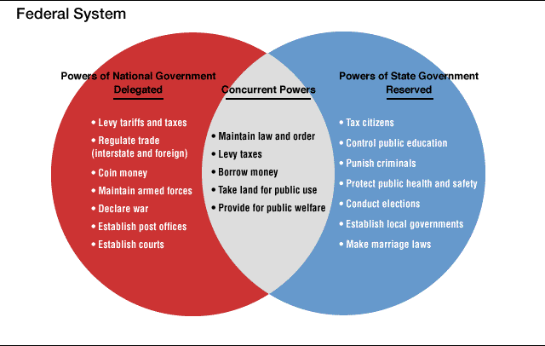

Slide 4
Put another way…
It allows local action on local matters and national actions on bigger concerns.
Example: Federal Government controls who we go to war with
While individual states decide if they want the death penalty or not.

Slide 5
For example…
Have you ever gotten gas in New Jersey? How did you get it?
Washington and Oregon allow physician assisted suicide.
Alaska, Delaware, new Hampshire, Montana and Oregon do not have sales tax.

Slide 6
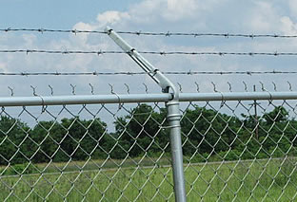
So what powers does the Federal government have?
3 Delegated (given to) powers
1. Expressed
2. Implied
3. Inherent

Slide 7
1. Expressed Powers
These powers are stated in the constitution (Article 1, Section 8)
Gives federal government 27 powers which include things like: tax, print money, regulate interstate commerce, declare war, control armed forces, etc etc.

Slide 8
2. Implied Powers
Not specifically stated in the constitution but reasonably suggested by the expressed powers

Slide 9
Where do the implied powers come from?
Art 1, Sec 8, Clause 18
Congress has the power:
“to make all laws which shall be necessary and proper for carrying into execution the foregoing powers and all other powers vested by this Constitution.”
This is sometimes called the elastic clause. Why?

Slide 10
Regulate Interstate Commerce
Pa gun crimes
Heart of Atlanta Motels (segregation)
National Highways

Slide 11
3. Inherent Powers
Powers that belong to the government because it is in charge of the country. Or These powers exist because the USA exists.
Powers include: regulate immigration, deport aliens, acquire territory, grant diplomatic recognition, protect the country from rebellion

Slide 12
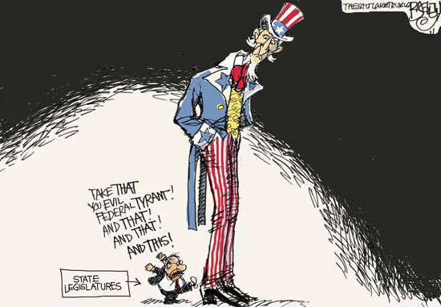

Slide 13
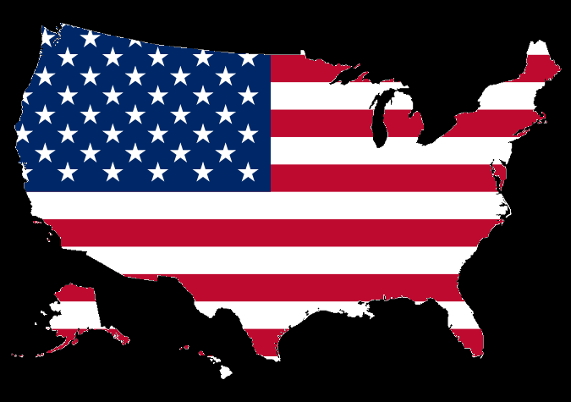
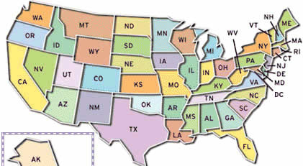
Recap
Powers/Duties
National Govt
Declare War
Concurrent
FBI/State Police
States
Public Schools
Expressed
Implied
Inherent
Don’t Forget the elastic/ necessary and proper clause!!!

Slide 14
Powers denied the Federal Government
1. Expressly
Ex: can’t take private property without payment, can’t prohibit free speech, can’t conduct illegal searches
2. Through Silence
Can’t create public schools, can’t set up local government
3. Because of federalism itself
Can’t tax states

Slide 15
The States
They are governments of reserved powers AKA they get all the powers that the federal government does not get that they also are not denied.
***10th Amendment***

Slide 16
What kind of laws can states enact? (almost anything)
Marriage age, sale of pornography, permit or prohibit gambling, lawyer/teacher licenses, public schools, land use, utilities, drinking age, etc etc etc. (Most things government does are done by the states, not the fed)

Slide 17
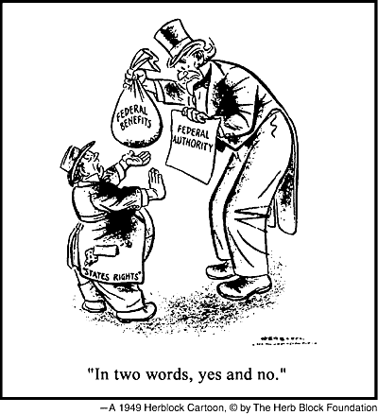
Why is the drinking age 21 in almost all states?

Slide 18
Powers denied to States
Can’t print money
Can’t make alliances
Can’t tax the federal government
Can’t deprive a person of life liberty or property without due process of law

Slide 19
Concurrent Powers (Overlap)
Some powers are shared or overlap between the federal government AND the states at the same time
Ex: tax, borrow money, establish courts, define crimes, environment and health standards, establish a police force, protect national borders

Slide 20
What if the laws conflict?
The Supremacy Clause (Art 6, Sec 2)
In a nutshell, the Constitution is #1, acts of congress and treaties are #2, then the state laws are #3.

Slide 21
How is the Supremacy Clause applied?
By the Supreme Court
Ex. McCulloch v. Maryland
“The states have no power to retard, impede, burden, or in any manner control, the operations of the constitutional laws enacted by congress”

Slide 22
Recap
States
Federal Government
Supreme Court

