Slide 1
Types of government

Slide 2
What is the united states?
Cracy = power
archy-= lead by
A democracy?
An infantocracy?
A gerontocracy?
An argentocracy?
An aristocracy?
A foolocracy?
An albocracy?
A meritocracy?
A theocracy?
An oligarchy?
An anarchy?
An aristararchy?
A monarchy?
A Corpoarchy?
A diaboloarchy?
A kleptoarchy?
A dictatorship?
A republic?

Slide 3
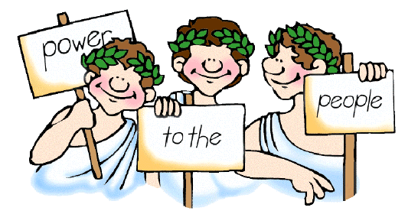

Slide 4
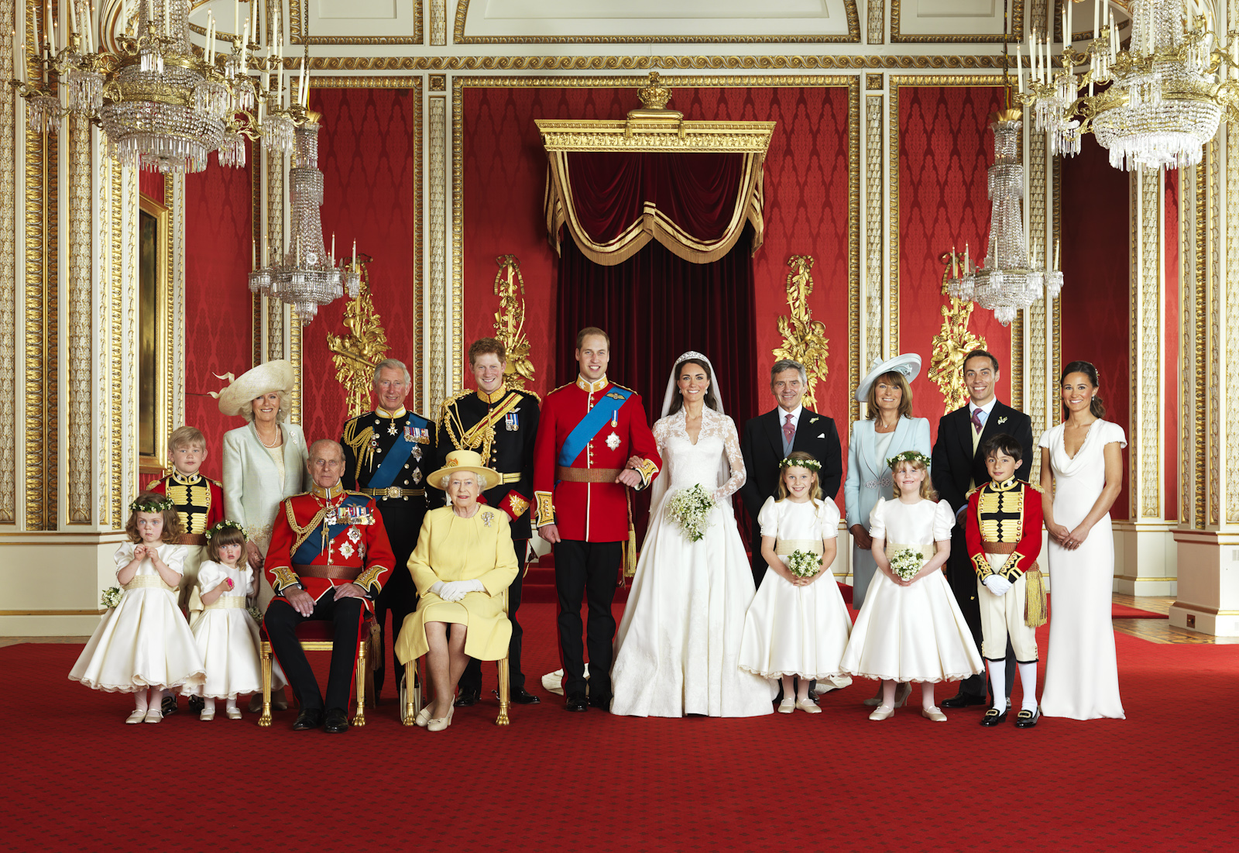

Slide 5
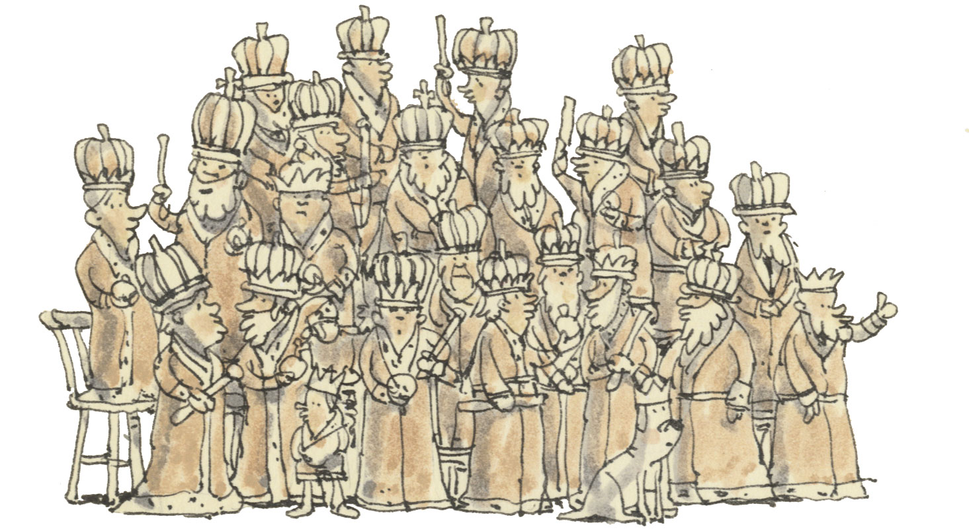

Slide 6
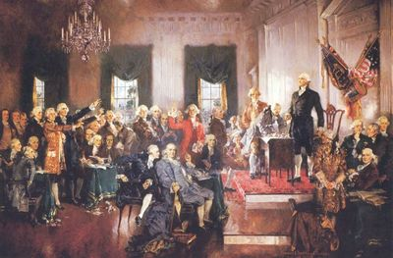

Slide 7
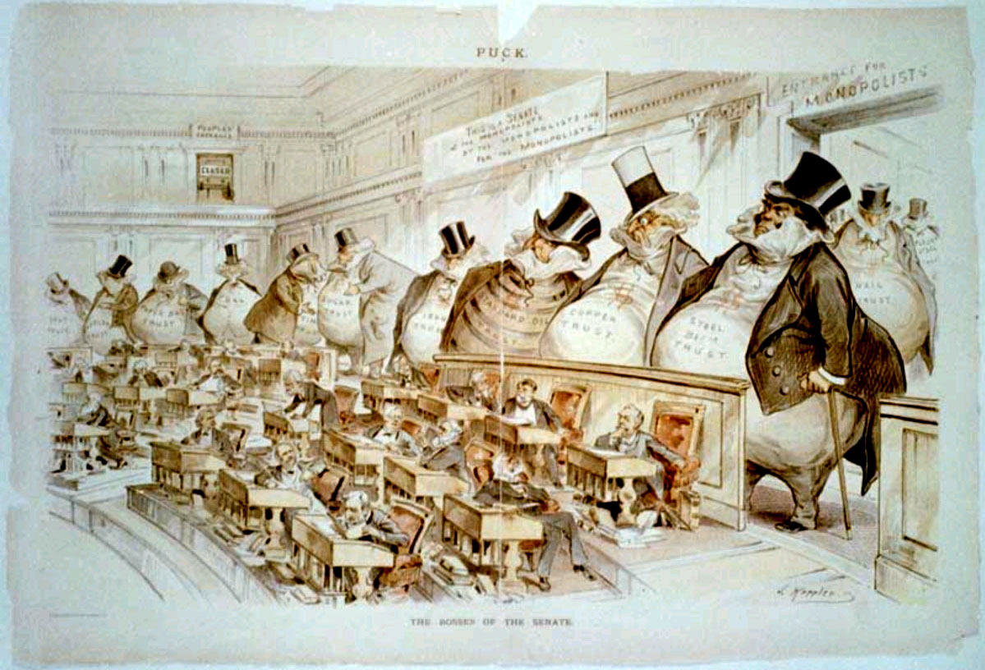

Slide 8
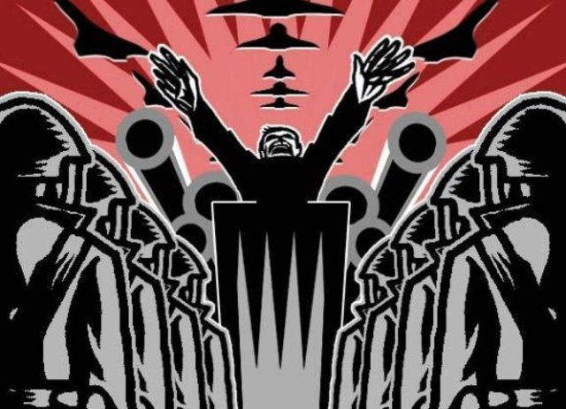

Slide 9
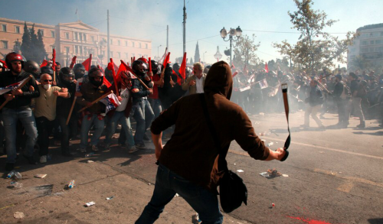

Slide 10
