Slide 1
Powers of Congress

Slide 2
National vs. State Government
Federalism: The idea that both the state & national government have powers.
http://bensguide.gpo.gov/9-12/government/federalism.html

Slide 3
Exclusive Powers of the National and State Governments
Expressed Powers
=
National
Reserved Powers
=
State
http://bensguide.gpo.gov/9-12/government/federalism2.html

Slide 4
Shared or Concurrent Powers
Collect taxes
Build roads
Borrow money
Establish courts
Make and enforce laws
Charter banks and corporations
Spend money for the general welfare
Take private property for public purposes, with just compensation

Slide 5
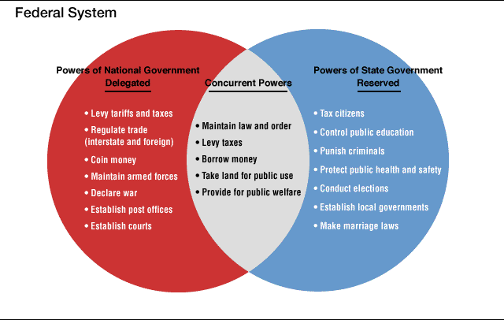

Slide 6
Powers Denied to the National and State Governments = Limited Government
Grant titles of nobility
Permit slavery (13th Amendment)
Deny citizens the right to vote due to race, color, or previous servitude (15th Amendment)
Deny citizens the right to vote because of gender (19th Amendment)
http://bensguide.gpo.gov/9-12/government/federalism3.html

