Slide 1
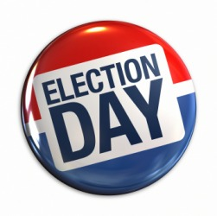
Election Process

Slide 2
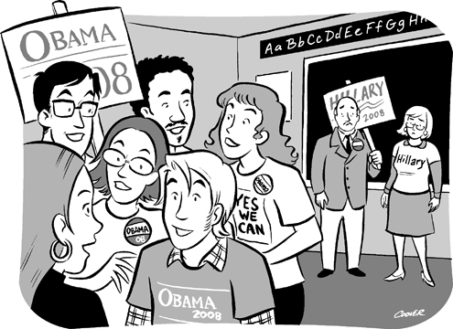
Election Campaigns
Nominating Candidates
Each state decides how candidates can be nominated
Caucuses – meeting of political party members to conduct party business and nominating candidates to local office
Nominating Conventions – elected members in an area attend conventions and choose candidate

Slide 3
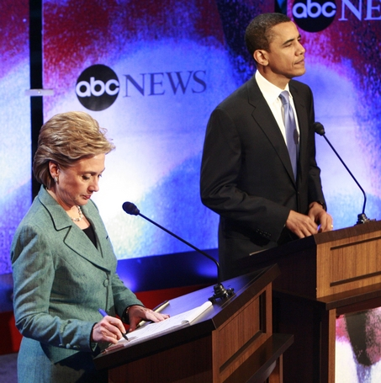
Election Campaigns
Nominating Candidates
Primary Elections – election held to elect candidates from each party
Closed Primary – only declared party members may vote
Open Primary – voters do not have to register, just have to choose which party to vote for before entering booth

Slide 4
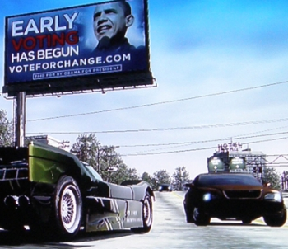
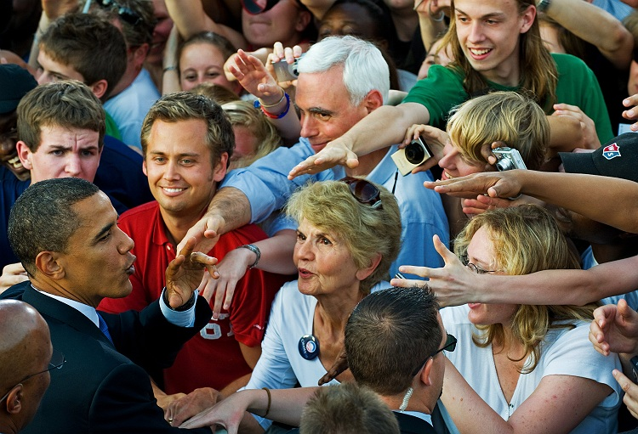
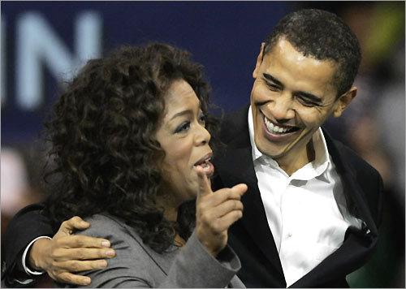
Election Campaigns
Running for Office
Endorsement – when people with power support a candidate
Advertising and Image molding
Canvassing – going through neighborhoods asking for votes

Slide 5
Election Campaigns
Financing Election Campaigns
Private funding – less than 10% from individuals
Political party contributions
PACs – Political Action Committees – political fundraising organizations who want to help a candidate

Slide 6
Election Campaigns
Public Funding – Taxpayers can contribute money from their tax refund to Presidential Campaign fund which is then divided up between the candidates

Slide 7
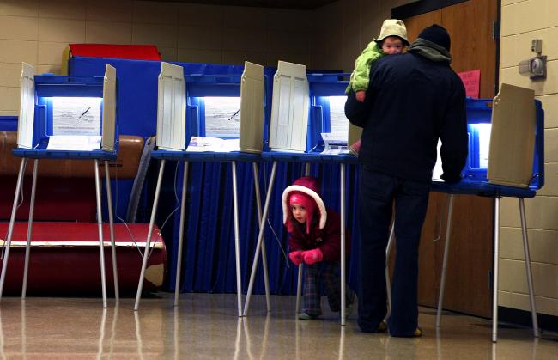
Elections
Primary Elections – elections held to elect candidates
General Elections
Voters cast ballots for candidates
Held first Tuesday after first Monday in November
Popular vote – votes cast by the people
Electoral vote – votes cast for President as part of the Electoral College

Slide 8
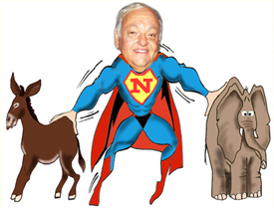
Elections
Non Partisan Elections – non party elections
Political parties are prohibited from participating
Candidates organize and run without party help

Slide 9
Elections
Special Elections
Run-off Elections – when there is a “tie” a run off must be held to determine a winner
Recall – voter can remove a public official from office

Slide 10
Types of Voting
Absentee voting – voting earlier than the election day
Those too ill or disabled
Those who will be away from their county
Those serving in the military
Straight Ticket/Party Voting – voting only for one political party
Split Ticket Voting – voting for different parties for different offices in the same election

Slide 11
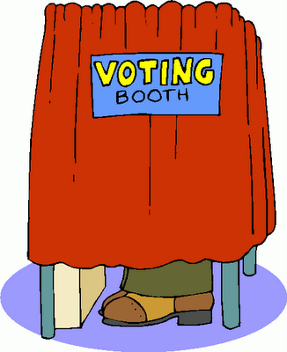
Types of Ballots
Ballots – device by which a voter registers a choice in an election
Paper Ballots – first used in our history
Australian Ballot
Four essential features of the Australian Ballot
It is printed at the public expense
It lists the names of ALL candidates in an election
It is given out ONLY at the polls, one per qualified voter
It is marked in secret

Slide 12
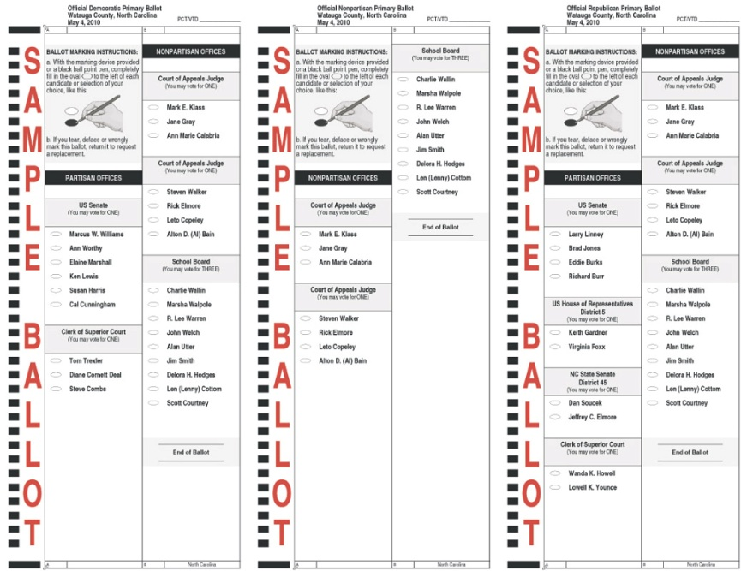
Types of Ballots
Two basic varieties of the Australian Ballot
Office group ballot
Original form of the Australian ballot
Can be called the Massachusetts ballot
Candidates are grouped together by which office they want to run for

Slide 13
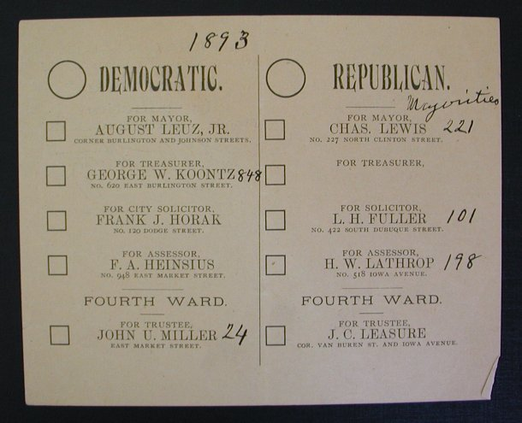
Types of Ballots
Party column ballot
Can be called the Indiana ballot
Each party’s candidates are listed in a column under the party’s name
There tends to be a box on this ballot to choose to vote for one political party only

Slide 14
Types of Ballots
Sample Ballots
Ballots that list all candidates for office to try to assist the voting public to make an informed choice
Bedsheet Ballots
A typically American ballot because of its length
Local levels where most often seen because many offices are listed
Voters can become apathetic because of the length of the ballot
The term associated with this is Ballot Fatigue

