Slide 1
Declaration of Independence
You will need a highlighter

Slide 2
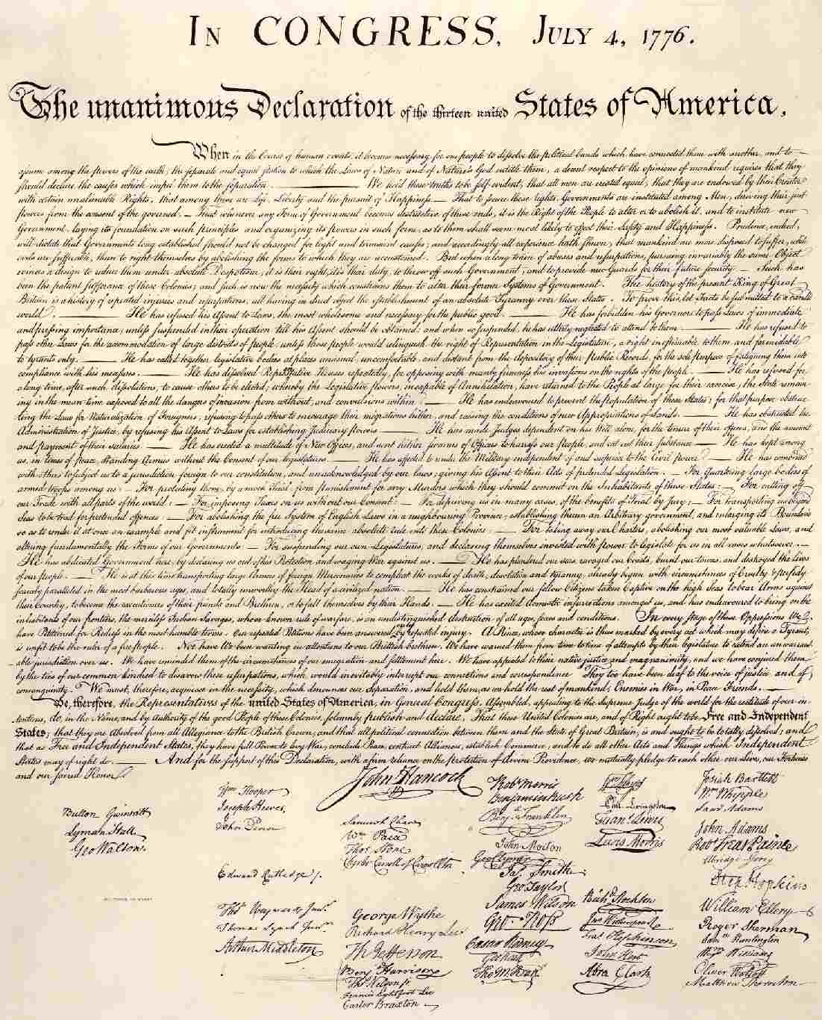

Slide 3
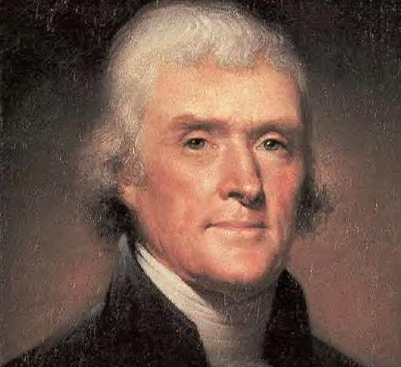
THE DECLARATION OF INDEPENDENCE
Date: July 4th 1776 (notice the Am. Rev. War began Apr. 1775)
Primarily written by Thomas Jefferson

Slide 4
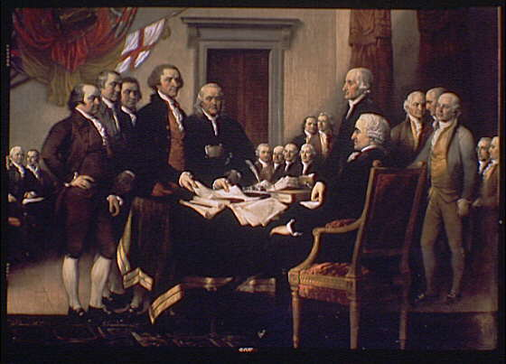

Slide 5
The Contents of the Declaration of Independence
Introduction – “Preamble”
Principles of the Declaration – Protection of our basic rights
Grievances (formal statement of complaint against the King of England)
Conclusion – Declaration of Independence from England

Slide 6
Introduction – “Preamble”
States the purpose of the document
“When in the courses of human events, it becomes necessary for one people to dissolve their political bands which have connected them with another”

Slide 7
Principles of the Declaration – Protection of our basic rights
“We hold these truths to be self evident, that all men are created equal, that they are endowed by their Creator with certain unalienable rights.”
Unalienable Rights of man – rights that cannot be taken away
“Life, Liberty, Pursuit of Happiness”
(The phrase, “unalienable rights,” is based on John Locke’s unalienable rights of life, liberty and property)

Slide 8
“Deriving their just powers from the consent of the governed.”
The governed is the people
This describes the concept of popular sovereignty
Popular sovereignty - Power rests with the people.

Slide 9
Grievances (formal statement of complaint against the King of England)
Complaints against the King of England
“He” refers to King George III
List of how the British Crown has failed to abide by the principles of a good government

Slide 10
Conclusion – Declaration of Independence from England
Colonists cut ties with England
Demands the sovereignty of American Colonies (supreme authority over a geographic region.)
“the United colonies” are “independent states”

