Slide 1
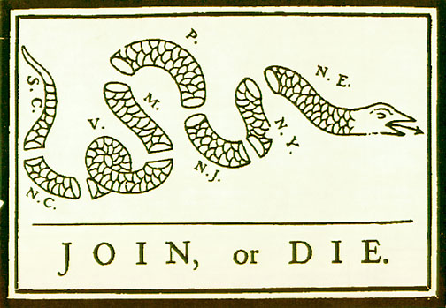
Articles of Confederation

Slide 2
Federalism – power shared between national and state governments Ratify - officially approve of something by signing or voting

Slide 3
ARTICLES OF CONFEDERATION
The first written government after the colonies declared independence from Great Britain
The Articles were problematic and did not work out… that is why we wrote The Constitution
Proposed by the Continental Congress July 12, 1776. Had to be ratified by all states.

Slide 4
Powers of Congress
Make war and peace
Send and receive ambassadors
Make treaties
Borrow money
Set up a money system
Establish post offices
Build a navy
Raise an army by asking the States for troops
Fix uniform standards of weights and measures
Settle disputes among the states

Slide 5
State Obligations – No way to force the states to do these things
Obey the Articles and acts of Congress
Provide funds and troops requested by Congress
Treat citizens from other States fairly and equally
Give full faith and credit to public acts, records, and judicial proceedings of other States
Surrender fugitives to one another
Submit disputes to Congress for settlement
Allow open travel and trade between and among the States

Slide 6
Problem with land and ratification
Each state was expected to help pay the war debt from the American Revolution
Several states claimed vast tracts of land between the Appalachian Mountains and the Mississippi River
States without land wanted the others to surrender their land to the new national government as payment.
States without land would not ratify the Articles unless states with land gave their land up.
VA and NY gave their land to Congress first. Then others followed suit.
RESULT = Articles ratified in 1781

Slide 7
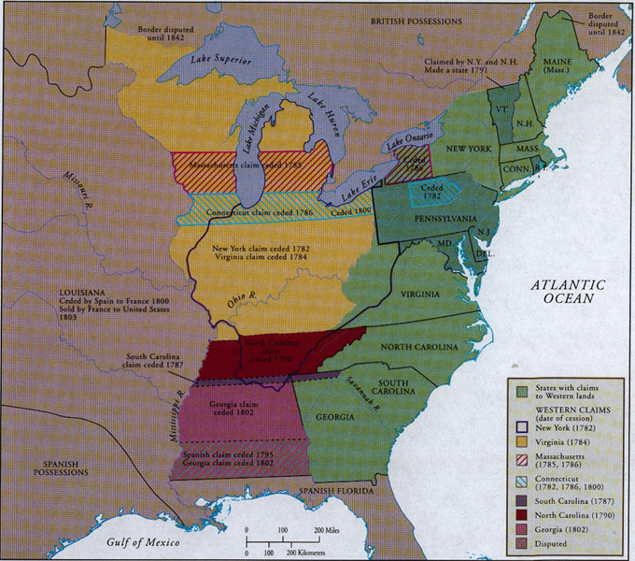

Slide 8
Land Ordinance of 1785
passed by Congress to regulate the disposal of western land. Land divided into townships (640 acres) to be sold at not less than $1/acre, with a section reserved for the est. of a school. First governmental aid toward public education

Slide 9
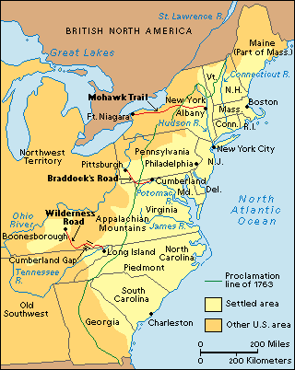

Slide 10
Northwest Ordinance of 1787
established a system for governing the Northwest Territory
Outline steps for statehood.
Present-day states of OH, IN, IL, MI, and WI created out of the territory.
Ensured eventual self-rule in the territory, guaranteed settlers civil rights, and banned slavery in the territory

Slide 11
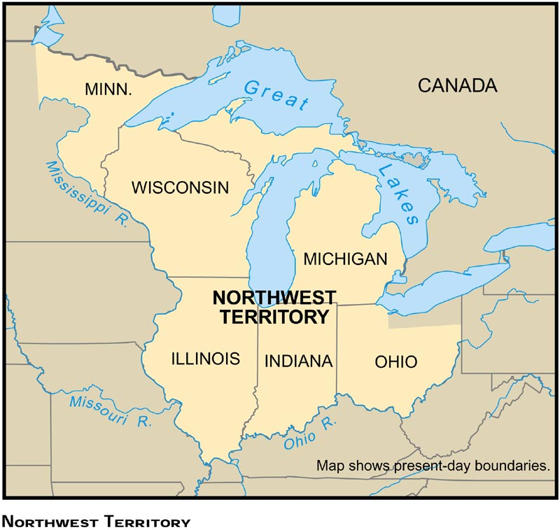

Slide 12
WEAKNESSES IN THE CONFEDERATION
One vote for each State, regardless of size
Congress powerless to collect taxes or duties
Congress powerless to regulate foreign and interstate commerce
No executive to enforce acts of Congress
No national court system
Amendments only added with consent of all States
9/13 states majority required to pass laws
Unanimous consent required to change the Articles
Articles only a “firm league of friendship”

Slide 13
Financial problems
when Congress couldn’t raise needed money from states, began to print money without the backing of gold or silver, called “Continentals.”
Seen as worthless by lenders and merchants. Led to massive inflation.
At the same time, nation experienced a depression in 1786, due primarily to loss of British markets and high unemployment.

Slide 14
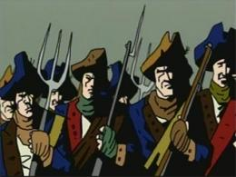
SHAY’S REBELLION
Depression hit farmers hard- few markets to sell goods, and most had little money to pay debts
In MA, legislature passed a heavy tax on land. Land would be seized if owners unable to pay. Outraged farmers in western Mass. petitioned legislature for relief. When nothing was done, farmers rebelled. July 1787, led by Daniel Shays, farmers shut down debtor courts and stopped property auctions. Later Shays and men set out to seize the federal arsenal in Springfield. Stopped by cannon fire and over 4,000 militiamen.

Slide 15
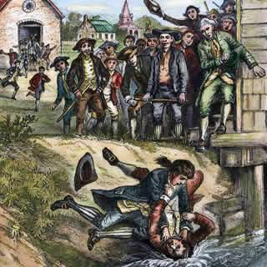

Slide 16
Legislature repealed direct taxes and passed debtor-relief legislation
Rebellion scared many, and led to doubts about the government’s ability to deal with civil unrest, and promote national unity. Led to calls for a stronger national government
EVENT HIGHLIGHTS WEAKNESSES IN THE ARTICLES OF CONFEDERATION

Slide 17
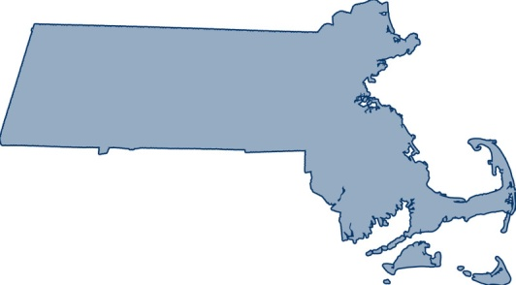
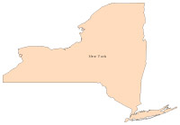
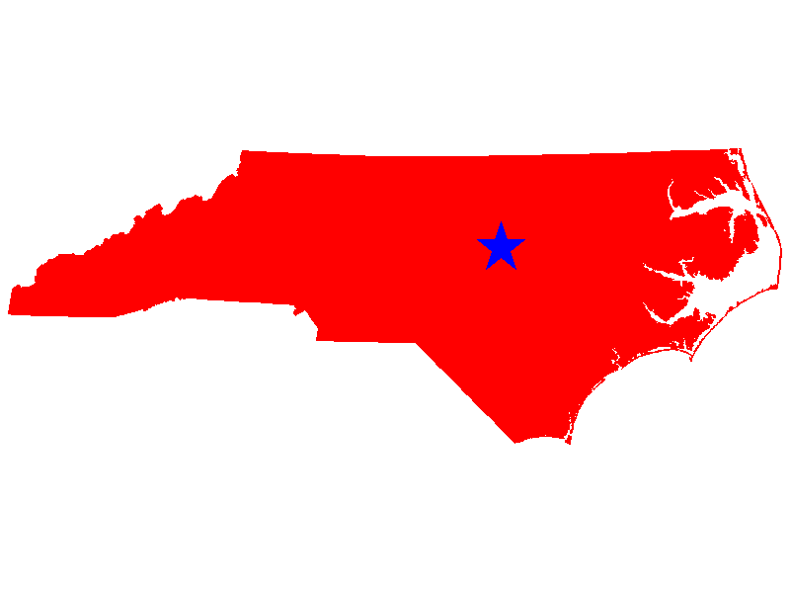
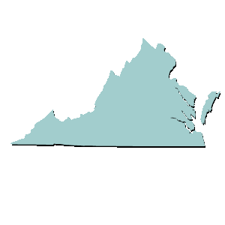
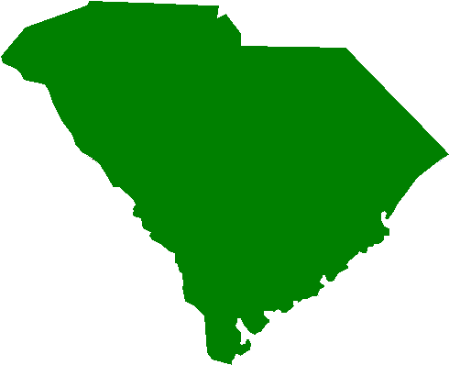
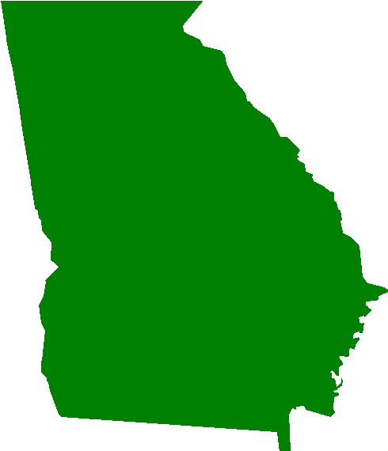
Articles of Confederation=
COLONIES UNTIED

