Slide 1
The Judicial Branch
By: Katie Dunn

Slide 2
Article III
The judicial power of the United States, shall be vested in one Supreme Court, and in such inferior courts as the Congress may from time to time ordain and establish. The judges, both of the supreme and inferior courts, shall hold their offices during good behaviour, and shall, at stated times, receive for their services, a compensation, which shall not be diminished during their continuance in office.
Judicial Review: The court can review any federal, state, or local law or action to see if it is Constitutional. Checks the legislative and executive!

Slide 3
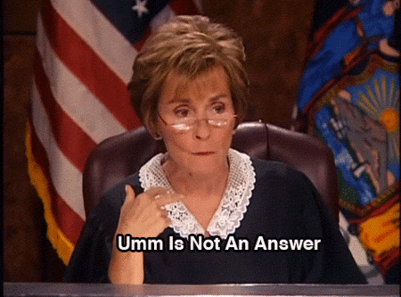
Types of cases:
Criminal cases – cases in which juries decide whether people have committed crimes
Civil cases – cases in which two sides disagree over some issue

Slide 4
What is jurisdiction? Court’s authority to hear and decide cases
Original Jurisdiction: Authority to hear a case for the first time
Appellate Jurisdiction: Authority of a court to hear a case appealed from a lower court in order to decide if the law was applied fairly
Exclusive Jurisdiction: Only the federal courts may hear and decide cases involving federal laws.
Concurrent Jurisdiction: Applies when state OR federal courts hear a case that violates both state and federal law.

Slide 5
Federal Courts vs State Courts
Federal courts have 3 levels-
SUPREME
APPELLATE
DISTRICT
State courts have 4 levels
SUPREME
APPELLATE
SUPERIOR
DISTRICT

Slide 6
The s.a.d. federal court cake
SUPREME (AKA SCOTUS)
1 chief justice + 8 associate justices = 9 Supreme Court justices
Appointed by the president & approved by the Senate
Original Jurisdiction in 2 situations: case involving foreign diplomats, or case between states
Appellate jurisdiction on Constitutional issues
APPELLATE
Appellate Courts, Circuit Courts, Court of Appeals, etc.
Has appellate jurisdiction
Appeal- review of lower court's decision
3 judge panel- no jury!
3 actions possible: overturn, deny, remand
DISTRICT
Has original jurisdiction for federal cases- 90% of all federal cases start here
94 courts total, with at least 1 per state
Cases heard by judge, jury, and magistrate
US Attorney- lawyer of the United States government
Only federal court to hear cases and reach verdicts (guilty/not guilty)

Slide 7
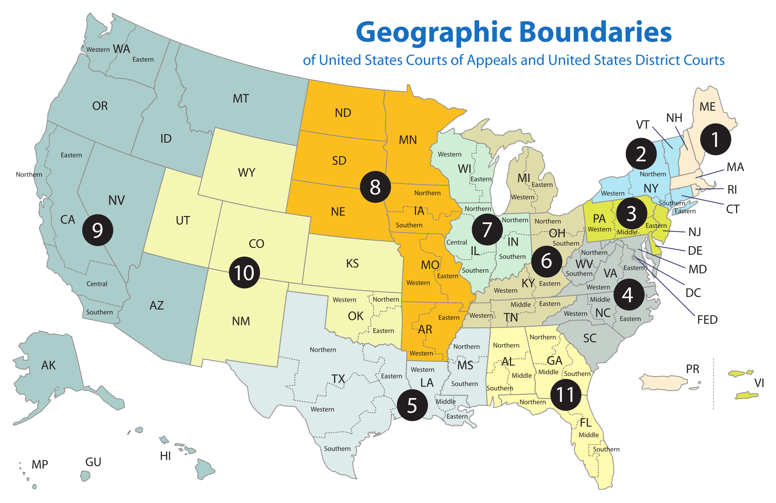

Slide 8
The S.a.s.d. State Courts
SUPREME
Only considers error in law. All decisions final unless appealed to US Supreme Court.
7 members: 1 chief and 6 associates
APPELLATE
15 Judges sit in rotating panels of 3 judges
Only review decisions on law from lower courts
SUPERIOR
Also called county court or circuit court and may be specialized in criminal, civil, or juvenile
Hears all felony cases, civil cases over 10,000 and serious juvenile cases
DISTRICT
Can be divided into 4 categories: criminal, civil, juvenile, and magistrate
NCDC’s sit in the county seat of each county
For civil cases such as divorce, child custody & support, civil cases less than $10,000, and criminal misdemeanors
Magistrate courts accept guilty pleas for minor misdemeanors, traffic violations, and civil cases less than $4,000

Slide 9
Federal Courts vs State Courts
Cases heard on a federal level
Cases heard on a state level
Involving the Constitution
Violations of Federal Laws
Controversies between states
Between parties from different states
Involving the federal government
Involving foreign governments and treaties
Based on Admiralty and Maritime Laws
Involving U.S. Diplomats
Most criminal cases,
Probate cases (involving wills and estates)
Most contract cases, personal injuries, family law (marriages, divorces, adoptions), etc.

Slide 10
Limits on power
Justices of the Supreme Court:
Appointed by the president, approved by a simple majority in the Senate
Like all federal judges, they serve life time limits
Cannot receive pay-cuts
Votes by the Chief Justice and Associate Justices are equal in power
Chief Justice presides over impeachment trials
Judges & Justices can be impeached & removed by Congress in the normal manner
Judges are bound by precedent. This is called the policy of stare decisis.
Legislative branch can overrule a court decision by changing a law or amending the Constitution
Presidents can override court verdicts with the clemency power
Can only hear and decide on federal level legal disputes, brought forth through appeal

Slide 11
Steps in decision making
How does a case reach the Supreme Court?
Writs of certiorari:
The Court grants a writ when it agrees to hear a case.
4 of 9 justices must agree to hear a case.
If the Court refuses to hear a case, then the lower court ruling stands.
The Court might refuse to hear if the case lacks national importance, if the issues at stake are too narrow (i.e., not a federal question), or if the Court is too divided on the matter.
Right of appeal:
The Court must hear appeals of decisions made by three-judge district courts. It can simply affirm or reverse the decision with a short statement.
In forma pauperis petition:
According to federal law, any indigent who takes a “pauper’s oath” postponing payment of required fees can submit a case to a federal court.
Most of these petitions are written by inmates in federal and state prisons.
Many petitions go unanswered; in rare instances, the Court holds hearings and reopens the case.
1.Written Arguments: Lawyers each prepare a brief for the justices to study
2. Oral Arguments: Lawyers have 30 minutes to present
3. Conference: On Friday, no audience or minutes kept, chief justices leads discussion, simple majority decides a case
4. Opinion Writing: majority opinion, concurring opinion, dissenting opinion, unanimous opinion
5. Announcement: Court announces its written decision(s), precedent is set once a decision is announced

