Slide 1
Rights, Responsibilities, and Duties

Slide 2
Rights
What citizens are entitled to are

Slide 3
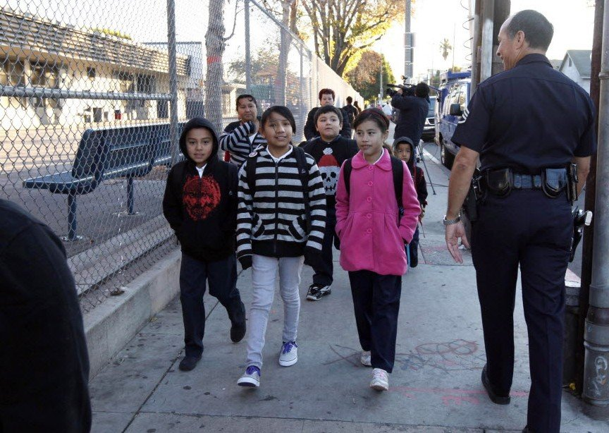
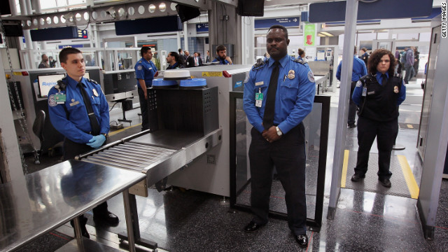
SECURITY:
Defending citizens and their lands from enemies
Governments set up military and police agencies
Security has been the cornerstone of most governments since governments began.

Slide 4
EQUALITY
All citizens of the United States are guaranteed equal treatment under the law

Slide 5
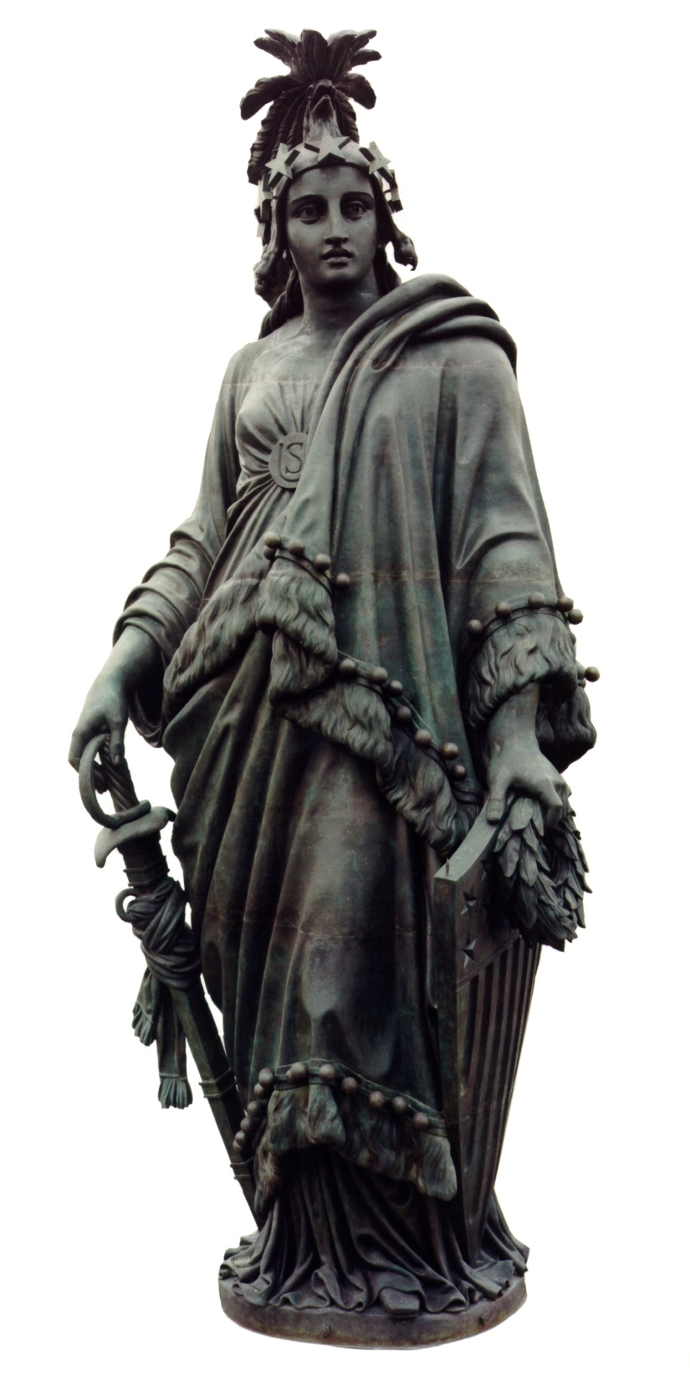
LIBERTY
Rights guaranteed by the Constitution and Bill of Rights
Amendments
Individual freedoms

Slide 6
DUTIES
The actions that are required of all U.S. Citizens are

Slide 7
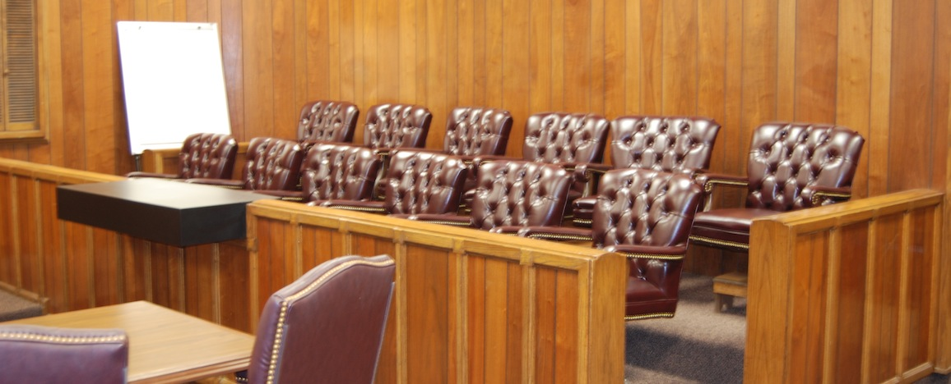
Jury Duty:
People can be excused from Jury Duty with a VALID reason.
So why stay on?
Every adult citizen has a chance of being called up.

Slide 8
The Draft
More formally known as Selective Services
All men have to register for it at 18
Multiple ways to get registered
And several drawbacks to not registering.

Slide 9
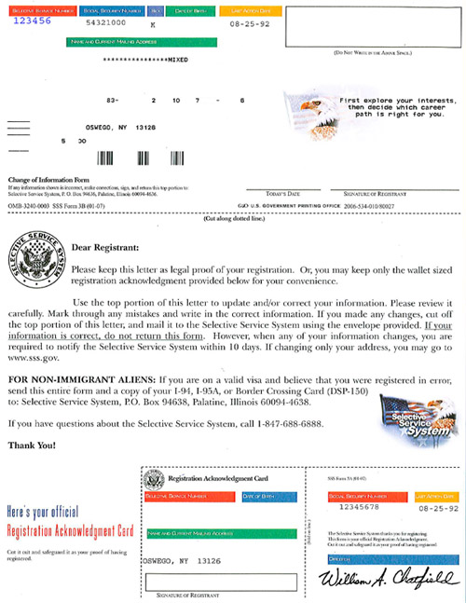

Slide 10
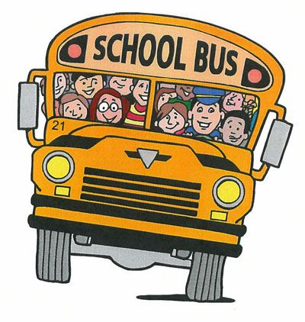
School
Public schools are free and in most states mandatory until the age of 16
Going to school benefits the people and the government
Fosters skills that create good, active citizens

Slide 11
Civic Responsibilities
The voluntary responsibilities of a citizen are

Slide 12
VOTE
Government based on “consent of the governed”
Essentially, the people are the source of all power in government
Therefore, If you don’t like something SPEAK UP! Odds are you WILL be heard

Slide 13
Be Informed
Be aware of what the state, local, and federal governments are doing
Charlotte City Council meets each Monday
State Legislature streams live audio
C-Span broadcasts the House and Senate on T.V.

Slide 14
Respect rights and diversity of others
Respecting the rights of others is necessary for an individual to enjoy his own rights
It is especially important to respect the civil liberties of others within a diverse population
“Respectful disagreement” is what makes a democracy a democracy.

Slide 15
Volunteering
Ways People
Volunteer
Donate Time: help mentor school kids
Donate Money: Give money to charities
Donate Food to food banks
Work on Political Campaigns
Why do we need volunteers? The government cannot provide all needed services as a result, volunteers meet the needs of others that are not met by government.

