Slide 1
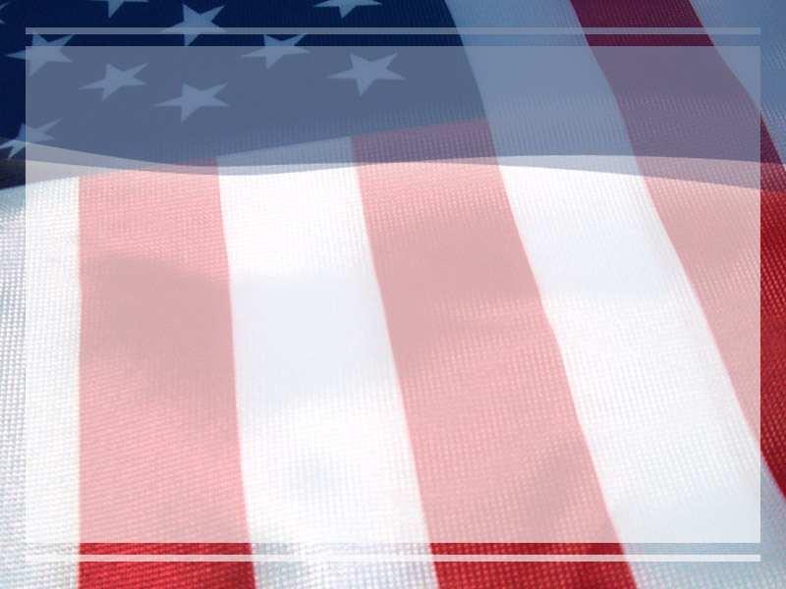
The Study
of Civics and
Economics

Slide 2
What is Civics? Economics?
Civics – the study of rights, duties and responsibilities of citizens of a nation
Economics – the study of choices:
People seek to satisfy their unlimited needs and wants when resources are limited
Need – something we need to survive; Ex. Food, shelter, air
Want – an item people desire but not essential to survival; Ex. IPods, clothes, cars
Scarcity – limited resources (things people use)

Slide 3
Citizenship

Slide 4
What is a citizen?
Citizen – a member of a nation who has certain rights, duties, and responsibilities. Citizens are loyal to the government, in return the government protects its citizens.
Nation or State – a group of people who share commonalities that organize power under a government

Slide 5
What is citizenship?
Citizens of a state must perform duties, should perform responsibilities, and should be granted rights.
Remember this… in a few days we will talk about Rights, Duties, and Responsibilities again.

Slide 6
How does one become a Citizen?
There are 2 ways a person may become a citizen…
By Birth
a. By Blood – parents are citizens
b. By Soil – born on U.S. land
2. Naturalization
a. USCIS (United States Citizenship and Immigration Services) handles the process of immigration into the United States
b. To become a citizen through USCIS you must have an interview, pass a citizenship test, and pledge an oath of alliegance

Slide 7
The
United
States

Slide 8
What is Culture?
Culture is the characteristics and knowledge of a particular group of people, defined by everything from language, religion, cuisine, social habits, music and arts.
I like to call our culture as Americans the ‘American Identity’.

Slide 9
What is the American Identity?
“E Pluribus Unum”
“Out of many, one”
A nation of Citizens, Immigrants, Aliens and Illegal immigrants
Immigrant – people legally admitted as permanent residents
Alien – a foreigner non-citizen who has permission (VISA) to be in the nation
Illegal immigrant – residing in a nation without permission from the government

Slide 10
A Melting Pot or A Tossed Salad?
Melting pot – a metaphor to describe a culture in which people from many cultures blend in, forming a new culture.
Tossed Salad – a metaphor used to describe a culture where individual people maintain their unique culture within the culture of a large group

Slide 11
Government

Slide 12
What is Government?
Government – the ruling authority of a society or community
Government is an institution that possesses power, structure, organization, values, legitimacy, processes and provide functions to its citizens

Slide 13
The 4 Functions of Government
Keep Order
  Pass and enforce laws, establish courts
Provide Services
  Schools, libraries, fire and police, unemployment insurance
Provide Security
  Prevent crime, protect citizens from foreign attack
Guide the Community
  Manage the economy, foreign relations, instill values

Slide 14
Foundations
of
American Government

Slide 15
The Roots of Our Government
Greece: democracy – the power of government rests with the citizens
  +
Rome: republic – the power of government rests with representatives who administer the institution
  =
  Thus… The United States is a democratic republic AKA a representative democracy

Slide 16
The Government
Of
The United States

Slide 17
What is the United States?
Cracy = power
Archy = lead by
A democracy?
An infantocracy?
A gerontocracy?
An argentocracy?
An aristocracy?
A foolocracy?
An albocracy?
A meritocracy?
A theocracy?
An oligarchy?
An anarchy?
An aristararchy?
A monarchy?
A Corpoarchy?
A diaboloarchy?
A kleptoarchy?
A dictatorship?
A republic?

